Slide 1
Challenge 2
CS-EEE
Introduction to the project:
Connected Bioreactor Control System

Slide 2


Challenge 2 – Interdisciplinary Project
BCG vaccine manufacturing facility in Uganda.
Need different expertise – Work TOGETHER to achieve bigger outcome!
BCG Plant in Uganda

Slide 3


Slide 4



Challenge 2 – Goal for CS/EEE
“Design, develop and test the circuitry, software and interfaces required to remotely monitor and control the parameters of a small-scale bioreactor system.”
BCG Plant in Uganda

Slide 5
Aims
Consider the design cycle - in particular the conception, implementation and testing phases.
Bring your disciplinary knowledge to a large problem.
Understand the complexity of design in large teams.

Slide 6
Technical Specification
Your Challenge is to design and develop a small-scale bioreactor system that:
Remotely monitors system parameters.
Provides the user with real-time system information.
Allows the user to control and adjust system parameters.
Logs the system parameters for process quality control.

Slide 7
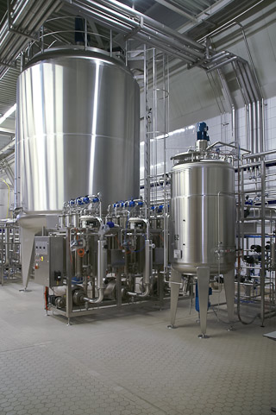
Objectives
During this challenge, you will:
Develop an overall system concept.
Break this down into subsystems.
Design, implement, test and refine
each subsystem.
Integrate the subsystems to demonstrate complete system operation.

Slide 8
Team Management
You will need to collaborate and communicate effectively to complete this project successfully. You will be asked to:
Assign different roles to each team member.
Determine the team members who will be working on the different subsystems.
Produce an implementation plan with clear milestones and actionable tasks.

Slide 9
Summative Deliverables for CS-EEE Cohort
Team proposal presentation (10%)
  Wednesday of week 5.
  Slides to be submitted by 9am 29th Oct.
Individual social impact report (10%)
  See the due date on Moodle.
Team demonstration (10%)
  Monday of Week 10.
Team report (30%)
  Due at the end of term.
  Not only to show the design but also the calibration and performance of their system.
Individual contribution to team work (10%)
  See the due date on Moodle.
Please also see tab called “Assessment Submission” on the ENGF0001 Moodle page for details.

Slide 10
Tasks for you today and this week (1)
In your team, research and brainstorm about:
What is a system?
What is a bioreactor system?
What is a connected system?
What is a control system?

Slide 11
Tasks for you today and this week (2)
In your team, continue to research and brainstorm about:
Connectivity
  Why do you want connectivity?
  What technologies are available for connectivity?
  What are the pros and cons of each technology?
Control
  What is required for a control system?
  What parameters need to be controlled in a bioreactor?
  What are the optimal values for the parameters?

